Slide 1
UNIT-2.6
INDEXES

Slide 2
SQL INDEX
The Index in SQL is a special table used to speed up the searching of the data in the database tables. It also retrieves a vast amount of data from the tables frequently. The INDEX requires its own space in the hard disk.
The index concept in SQL is same as the index concept in the novel or a book.
It is the best SQL technique for improving the performance of queries. The drawback of using indexes is that they slow down the execution time of UPDATE and INSERT statements. But they have one advantage also as they speed up the execution time of SELECT and WHERE statements.
In SQL, an Index is created on the fields of the tables. We can easily build one or more indexes on a table. The creation and deletion of the Index do not affect the data of the database.

Slide 3
Why SQL Index?
The following reasons tell why Index is necessary in SQL:
SQL Indexes can search the information of the large database quickly.
This concept is a quick process for those columns, including different values.
This data structure sorts the data values of columns (fields) either in ascending or descending order. And then, it assigns the entry for each value.
Each Index table contains only two columns. The first column is row_id, and the other is indexed-column.
When indexes are used with smaller tables, the performance of the index may not be recognized.
Create an INDEX
In SQL, we can easily create the Index using the following CREATE Statement:
CREATE INDEX Index_Name ON Table_Name ( Column_Name);
Here, Index_Name is the name of that index that we want to create, and Table_Name is the name of the table on which the index is to be created. The Column_Name represents the name of the column on which index is to be applied.
If we want to create an index on the combination of two or more columns, then the following syntax can be used in SQL:
CREATE INDEX Index_Name ON Table_Name ( column_name1, column_name2, ...., column_nameN);

Slide 4
Example for creating an Index in SQL:
Let's take an Employee table:
Emp_Id | Emp_Name | Emp_Salary | Emp_City | Emp_State
1001 | Akshay | 20000 | Noida | U.P
1002 | Ram | 35000 | Jaipur | Rajasthan
1003 | Shyam | 25000 | Gurgaon | Haryana
1004 | Yatin | 30000 | Lucknow | U.P
The following SQL query creates an Index 'Index_state' on the Emp_State column of the Employee table.

Slide 5
CREATE INDEX index_state ON Employee (Emp_State);
Suppose we want to create an index on the combination of the Emp_city and the Emp_State column of the above Employee table. For this, we have to use the following query:
CREATE INDEX index_city_State ON Employee (Emp_City, Emp_State);
Create UNIQUE INDEX
Unique Index is the same as the Primary key in SQL. The unique index does not allow selecting those columns which contain duplicate values.
This index is the best way to maintain the data integrity of the SQL tables.
Syntax for creating the Unique Index is as follows:
CREATE UNIQUE INDEX Index_Name ON Table_Name ( Column_Name);
Example for creating a Unique Index in SQL:
Let's take the above Employee table.
The following SQL query creates the unique index index_salary on the Emp_Salary column of the Employee table.
CREATE UNIQUE INDEX index_salary ON Employee (Emp_Salary);

Slide 6
Rename an INDEX
We can easily rename the index of the table in the relational database using the ALTER command.
Syntax:
ALTER INDEX old_Index_Name RENAME TO new_Index_Name;
Example for Renaming the Index in SQL:
The following SQL query renames the index 'index_Salary' to 'index_Employee_Salary' of the above Employee table:
ALTER INDEX index_Salary RENAME TO index_Employee_Salary;
Remove an INDEX
An Index of the table can be easily removed from the SQL database using the DROP command. If you want to delete an index from the data dictionary, you must be the owner of the database or have the privileges for removing it.
Syntaxes for Removing an Index in relational databases are as follows:
In Oracle database:
DROP INDEX Index_Name;
In MySQL database:
ALTER TABLE Table_Name DROP INDEX Index_Name;
In Ms-Access database:
DROP INDEX Index_Name ON Table_Name;
In SQL Server Database:
DROP INDEX Table_Name.Index_Name;

Slide 7
Example for removing an Index in SQL:
Suppose we want to remove the above 'index_Salary' from the SQL database. For this, we have to use the following SQL query:
DROP INDEX index_salary;
Alter an INDEX
An index of the table can be easily modified in the relational database using the ALTER command.
The basic syntax for modifying the Index in SQL is as follows:
ALTER INDEX Index_Name ON Table_Name REBUILD;
When should INDEXES not be used in SQL?
The Indexes should not be used in SQL in the following cases or situations:
SQL Indexes can be avoided when the size of the table is small.
When the table needs to be updated frequently.
Indexed should not be used on those cases when the column of a table contains a large number of NULL values.

Slide 8
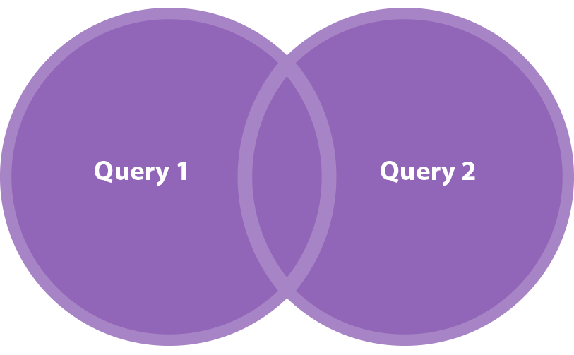
The UNION Set Operator
What if we wanted to make one table from all the content in the BOOKS and MOVIES tables? This is a perfect time to use UNION set operator.
UNION merges the results of two SELECT statements. Important: UNION statements only return UNIQUE values. Below, you'll see a Venn diagram representing this operation and the code that will make it happen:

Slide 9
SELECT * FROM BOOKS
UNION
SELECT * FROM MOVIES
Here is the result:
ID Title
1 The Witcher
2 Harry Potter
3 Nineteen Eighty-Four
4 The Great Gatsby
5 Iron Man
6 Dr Strange
7 Matrix
All the book and movie titles are now in one table. Note that "Harry Potter" – an item which appears in both tables – is shown only once in the results. Like we mentioned earlier, the UNION set operator does not return duplicate values.

Slide 10
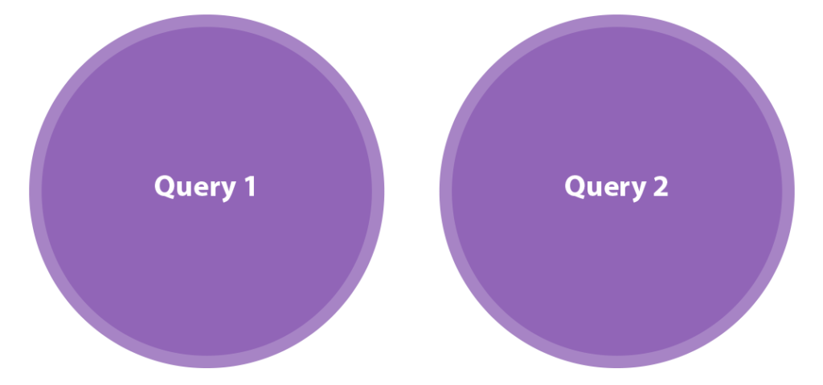
The UNION ALL Set Operator
You've probably guessed that UNION ALL is very similar to UNION, but with one exception: UNION ALL returns all data from all tables, no matter if it is a duplicate or not. Let's do the same operation as in the UNION example and see what we get:

Slide 11
SELECT * FROM BOOKS
UNION ALL
SELECT * FROM MOVIES
ID Title
1 The Witcher
2 Harry Potter
3 Nineteen Eighty-Four
4 The Great Gatsby
5 Iron Man
6 Harry Potter
7 Dr Strange
8 Matrix
Firstly, know that there is a huge difference in efficiency between them. Let's say we need to merge two query results that each contain 10,000 elements. UNION will eliminate any duplicates and sort all the elements in the results table. This sorting process takes a lot of time and works with a large number of elements.
In sum, UNION can be four times slower than UNION ALL, which doesn't eliminate duplicates and doesn't sort the data. If we don't care about duplicates and we want to work fast, UNION ALL will be the perfect solution. But if we know that having unique elements is our main goal, then UNION will be much more helpful.

Slide 12
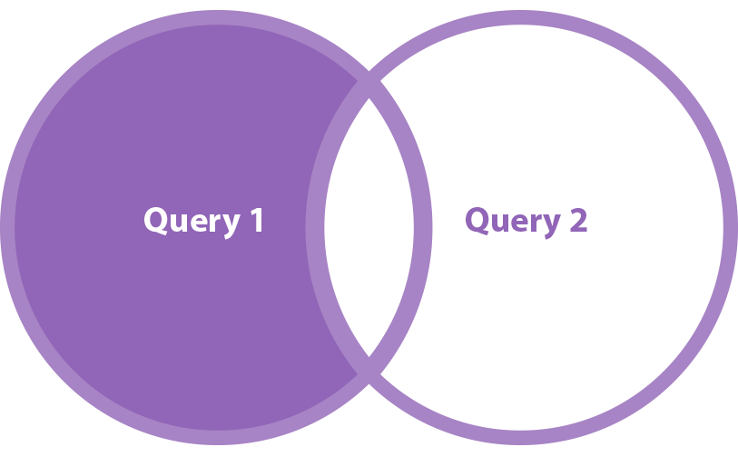
The MINUS Set Operator
MINUS is a little bit different. Let's say we want to see only book titles that are not also movie titles. We need to "minus" everything from the BOOKS table that is also in the MOVIES table. The MINUS set operator is designed for this type of task.

Slide 13
SELECT * FROM BOOKS
MINUS
SELECT * FROM MOVIES
The result:
ID Title
1 The Witcher
2 Nineteen Eighty-Four
3 The Great Gatsby
Now "Harry Potter" doesn't appear in the results table; it's the title of a book and a movie. Thanks to the MINUS set operator we are able to see only those titles that occur in the first table and are not present in the second.
By the way, some databases use the keyword EXCEPT instead of MINUS. Don't worry – the function and results are exactly the same.

Slide 14
The INTERSECT set Operator
This is the main role of the INTERSECT operator. Let's see how it works.
SELECT * FROM BOOKS
INTERSECT
SELECT * FROM MOVIES
And the result:
ID Title
1 Harry Potter

Slide 15
SEQUENCES
Sequence is a set of integers 1, 2, 3, … that are generated and supported by some database systems to produce unique values on demand.
A sequence is a user defined schema bound object that generates a sequence of numeric values.
Sequences are frequently used in many databases because many applications require each row in a table to contain a unique value and sequences provides an easy way to generate them.
The sequence of numeric values is generated in an ascending or descending order at defined intervals and can be configured to restart when exceeds max_value.

Slide 16
Syntax:
CREATE SEQUENCE sequence_name
START WITH initial_value
INCREMENT BY increment_value
MINVALUE minimum value
MAXVALUE maximum value
CYCLE|NOCYCLE ;
sequence_name: Name of the sequence.
initial_value: starting value from where the sequence starts.
Initial_value should be greater than or equal
to minimum value and less than equal to maximum value.
increment_value: Value by which sequence will increment itself.
Increment_value can be positive or negative.
minimum_value: Minimum value of the sequence.
maximum_value: Maximum value of the sequence.
cycle: When sequence reaches its set_limit
it starts from beginning.
nocycle: An exception will be thrown
if sequence exceeds its max_value.

Slide 17
Example 1:
CREATE SEQUENCE sequence_1
start with 1
increment by 1
minvalue 0
maxvalue 100
cycle;
Above query will create a sequence named sequence_1.Sequence will start from 1 and will be incremented by 1 having maximum value 100. Sequence will repeat itself from start value after exceeding 100.
Example 2:
Following is the sequence query creating sequence in descending order.
CREATE SEQUENCE sequence_2
start with 100
increment by -1
minvalue 1
maxvalue 100
cycle;

Slide 18
Example to use sequence : create a table named students with columns as id and name.
CREATE TABLE students
(
ID number(10),
NAME char(20)
);
Now insert values into table
INSERT into students VALUES(sequence_1.nextval,'Ramesh');
INSERT into students VALUES(sequence_1.nextval,'Suresh');
where sequence_1.nextval will insert id’s in id column in a sequence as defined in sequence_1.
Output:
______________________
| ID | NAME |
------------------------
| 1 | Ramesh |
| 2 | Suresh |
----------------------

